Slide 1
A Systematic Review of Transformation Approaches between User Requirements and Analysis Models
Li Yi
2011.12.19

Slide 2
About the Paper
A systematic review of transformation approaches between user requirements and analysis models
Tao Yue • Lionel C. Briand • Yvan Labiche, Simula Research Laboratory, University of Oslo
RE Journal, June, 2011

Slide 3
Outline
Introduction
Conceptual Framework
Evaluation of the Approaches
Suggestions

Slide 4
Introduction
Model Transformation in MDA
Requirements
Approaches reviewed in this paper
?
Analysis Model
(PIM)
Design Model
(PSM)
Traditional MDA Lifecycle
Code

Slide 5
Scope of the Reviewed Approaches
Pure textual descriptions
Use cases
Customized document templates
Requirements
16 Approaches
UML models
Message Sequence Charts
Entity Relationship Diagrams
Analysis Model
(PIM)
An analysis model is a description of what a system is required to do functionally and aims to be less ambiguous and more correct and consistent than textual requirements
——Bruegge B, Dutoit AH (2004) Object-oriented software engineering
using UML, patterns, and Java, 2nd ed. Prentice Hall

Slide 6
Outline
Introduction
Conceptual Framework
Evaluation of the Approaches
Suggestions

Slide 7
Overview
Contents in the conceptual framework
Taxonomy of …
Requirements
Restriction rules (on the use of language in requirements)
Analysis models
Requirements pre-processing (i.e. natural language processing) approaches
Transformation approaches
Process Model

Slide 8
Taxonomy of Requirements
Requirements Representation
None (i.e. unstructured natural language)
Use case
Document template
Requirements Supplements (Domain Specific Information, or DSI)
Glossary
Definition
Domain model (Domain concepts + relationships)
Natural Language
Restricted (on grammar and vocabulary)
Free

Slide 9
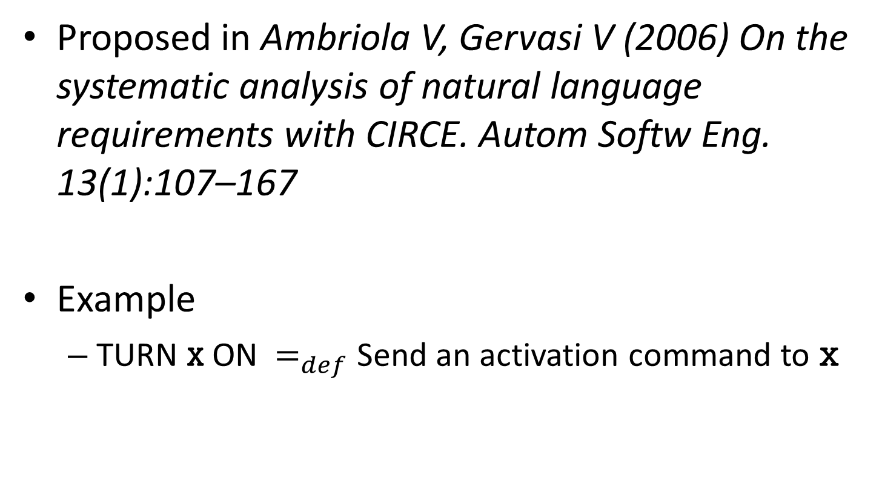
What is a Definition?
Proposed in Ambriola V, Gervasi V (2006) On the systematic analysis of natural language requirements with CIRCE. Autom Softw Eng. 13(1):107–167
Example
TURN x ON $=_{def}$ Send an activation command to x

Slide 10
Taxonomy of Restriction Rules
Sentence Restriction
Restrictions on tenses of verb, etc.
“Use active voice rather than passive voice”
Sentence Structure Restriction
Restrictions on clauses
“Use if–then structure to describe conditional sentence”
Wording Restriction
Restrictions on choice of words
“Use be or become to express a generalization relationship between the subject and the object of a sentence”

Slide 11
Taxonomy of Analysis Models
Structure
Class Diagram
Object Diagram
Entity Relationship Model
Architecture Concept
Behavior
Sequence Diagram
State Machine Diagram
Activity Diagram
Data Flow Graph
Message Sequence Chart

Slide 12
Taxonomy of Requirements Preprocessing Approaches
Lexical Analysis
Output: nouns, verbs, adjectives, etc.
Stemming
Syntactic Analysis
Output: grammar tree
Semantic Analysis
Output: grammar tree + domain specific info
Categorization
Classify the requirements (often manually done)
Pragmatic Analysis
Eliminate ambiguities and inconsistencies in the text

Slide 13
Taxonomy of Transformation Approaches
Rule based (most common)
Ontology based
Use an ontology model as an intermediate model
Identity Transformation
Two models describe the same concepts but with different representations
Pattern based
A set of source elements → A set of target elements

Slide 14
Process Model
1. Pre-process requirements (PPR)
If has Intermediate Model
2. Transform PPR to Intermediate Model
3. Transform between Intermediate Models (IM)
4. Transform IM to Analysis Model (AM)
5. Derive traceability (PPR <-> AM) from traceability between IMs
Else
6. Transform PPR to AM
7. Establish traceability between PPR and AM

Slide 15
Outline
Introduction
Conceptual Framework
Evaluation of the Approaches
Suggestions

Slide 16
Evaluation Criteria (1/2)
1. Difficulty of documenting requirements
How difficult it is to document requirements in the format required by a specific approach
2. Completeness of generated analysis model
Structure + Behavior = Complete
3. Automation
automated, automatable, semi-automated, manual
4. Efficiency
How many steps; How many pre-processing techniques

Slide 17
Evaluation Criteria (2/2)
5. Case study of the approach
Size and number of the case studies
Results
Other evaluations besides case study
6. Support for traceability: YES or NO
7. Completeness of transformation rules
According to requirements constructs
8. Structuredness of transformation rules
Source language, target language
Is every rule well-specified?

Slide 18
Difficulty of Documenting Requirements
<DSI, Representation, Natural Language> (16 approaches total)
1. <None, None, Free> (8 approaches)
2. <Glossary + Definition, None, Free>
3. <None, OBFS, Restricted>
4. <None, Use cases, Free> (3 approaches)
5. <None, Use cases, Restricted>
6. <Glossary, Use cases, Restricted>
7. <Domain model, Use cases, Restricted>
7 > 2, 3, 6 > 5 > 4 > 1

Slide 19
OBFS
Object-Based Formal Specification
Wahono RS, Far BH (2002) A framework for object identification and refinement process in object-oriented analysis and design. In: Proceedings of cognitive informatics, pp 351–360
OBFS = Description (System Overview) + Collaborative (Objects and Associations) + Attribute (of Objects) + Behavior (of Objects) + Inheritance (between Objects)

Slide 20
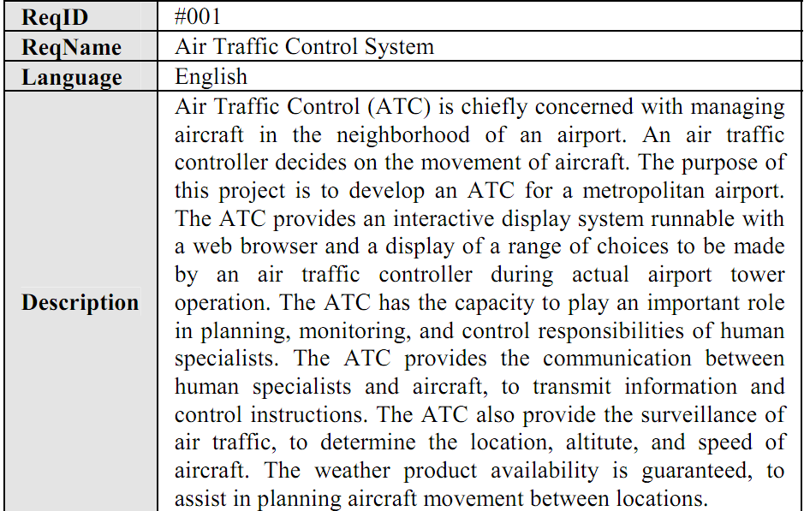
Example: Description

Slide 21
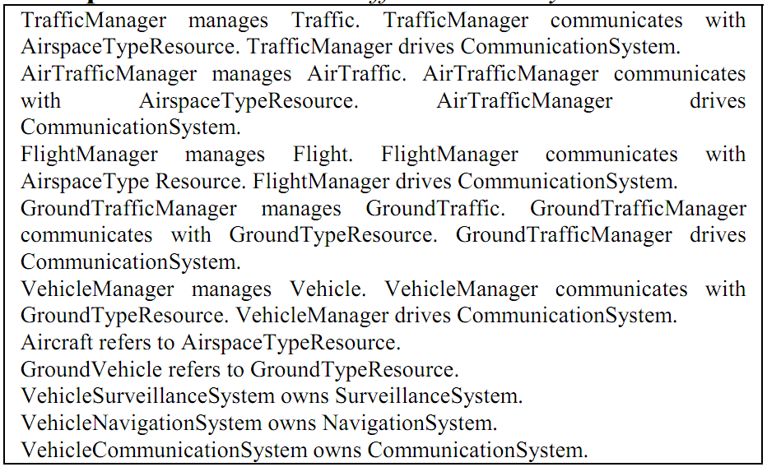
Example: Collaborative

Slide 22
Some Results
Approaches requiring more user effort to document requirements achieve better automation and higher efficiency.
Use cases are the most frequently applied requirements representation.
Lexical analysis is the most commonly used pre-processing technique.
Most of the reviewed approaches have one intermediate model. Rule-based transformations are most frequently used.

Slide 23
Outline
Introduction
Conceptual Framework
Evaluation of the Approaches
Suggestions

Slide 24
Approach Configuration
It is desirable only to demand a textual glossary as DSI
Use cases should be supported as they are most frequently used for requirements representation
Restricted NL might be used for documenting requirements so that automated transformation can be facilitated.
Recommended (DSI information, requirement representation, NL) composition:
(None / Glossary, Use cases, Free / Restricted)

Slide 25
Use one intermediate model and fully automatable requirements pre-processing techniques (e.g., lexical analysis and syntactic parsing).
If user interventions are required during transformations, it is important that the intermediate model be easy to understand by users.

Slide 26
Transformation
The Atlas Transformation Language (ATL) of the Eclipse platform
Specification, structuring (by packaging rules into modules), and execution of transformation rules
Both declarative and imperative constructs to define transformation rules
Results from previously executed rules cannot be used as inputs of other rules.
Kermeta is an imperative metamodeling language, also built on top of the Eclipse platform
Also supports packages, inheritance, classes, and operations so that transformation rules can be well organized.
Rules support pre, post conditions and invariants.
IBM Model Transformation Framework (MTF)
Query/View/Transformation (QVT) standard
We suggest that requirements are transformed into an intermediate model, then it is transformed into an analysis model by applying one of the model-to-model transformation techniques.

Slide 27
Appendix a: LIST of the approaches (INPut & output)

Slide 28
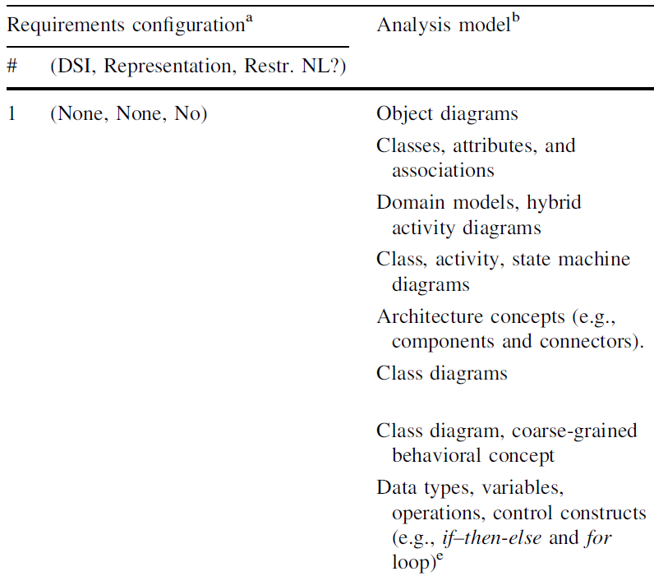
1
2
3
4
5
6
7
8

Slide 29
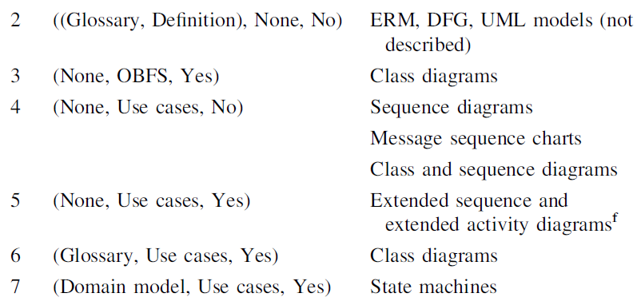
9
10
11
12
13
14
15
16

Slide 30
Mich L (1996) NL-OOPS: from natural language to object oriented requirements using the natural language processing system LOLITA. Nat Lang Eng 2(02):161–187
Harmain HM, Gaizauskas R (2003) CM-Builder: a natural language-based CASE tool for object-oriented analysis. Autom Softw Eng 10(2):157–181
Ilieva MG, Ormandjieva O (2006) Models derived from automatically analyzed textual user requirements. In: Proceedings on software engineering research, management and applications
Fliedl G, Kop C, Mayr HC, Salbrechter A, Vo¨hringer J, Weber G, Winkler C (2007) Deriving static and dynamic concepts from software requirements using sophisticated tagging. Data Knowl Eng 61(3):433–448
Grubacher P, Egyed A, Medvidovic N (2004) Reconciling software requirements and architectures with intermediate models. Softw Syst Model 3(3):235–253
Overmyer SP, Benoit L, Owen R (2001) Conceptual modeling through linguistic analysis using LIDA. In: ICSE’01, 2001, pp 401–410
Capuchino AM, Juristo N, Van de Riet RP (2000) Formal justification in object-oriented modelling: a linguistic approach. Data Knowl Eng 33(1):25–47
Abbott RJ (1983) Program design by informal English descriptions. Com ACM 26(11):882–894
Ambriola V, Gervasi V (2006) On the systematic analysis of natural language requirements with CIRCE. Autom Softw Eng 13(1):107–167
Wahono RS, Far BH (2002) A framework for object identification and refinement process in object-oriented analysis and design. In: Proceedings of cognitive informatics, pp 351–360

Slide 31
Diaz I, Pastor O, Matteo A (2005) Modeling interactions using role-driven patterns. In: Proceedings of IEEE international conference on requirements engineering, pp 209–220
Feijs LMG (2000) Natural language and message sequence chart representation of use cases. Inf Softw Technol 42(9):633–647
Insfra´n E, Pastor O, Wieringa R (2002) Requirements engineering- based conceptual modelling. Requir Eng 7(2):61–72
Smiałek M, Bojarski J, Nowakowski W, Ambroziewicz A, Straszak T (2007) Complementary use case scenario representations based on domain vocabularies. In: Proceedings on MoDELS
Subramaniam K, Liu D, Far BH, Eberlein A (2004) UCDA: Use case driven development assistant tool for class model generation. In: Proceedings of SEKE’04
Samarasinghe N, Some´ S (2005) Generating a domain model from a use case model. In: Proceedings on intelligent and adaptive systems and software engineering

Slide 32
Appendix b: Restriction & transformation rules (EXAMPLE)

Slide 33
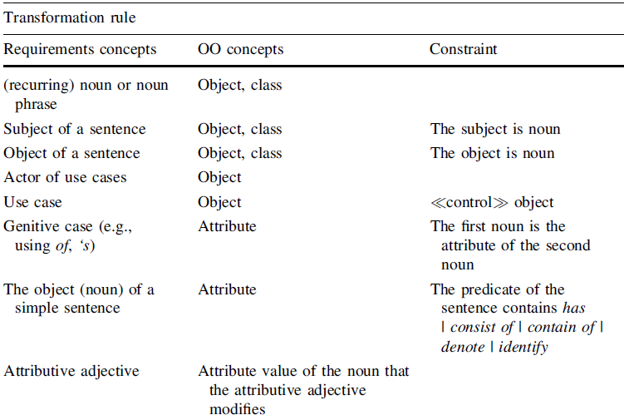

Slide 34
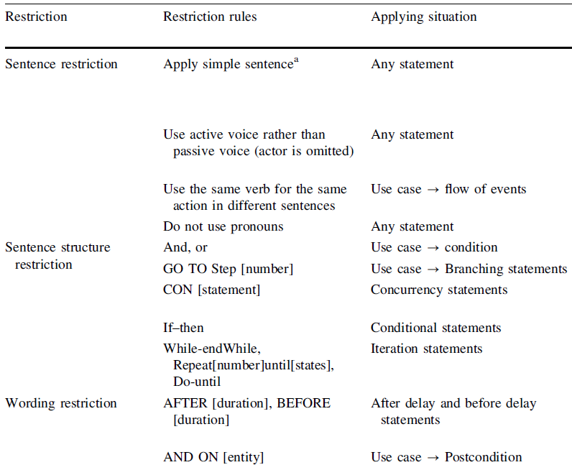

Slide 35
